Slide 1
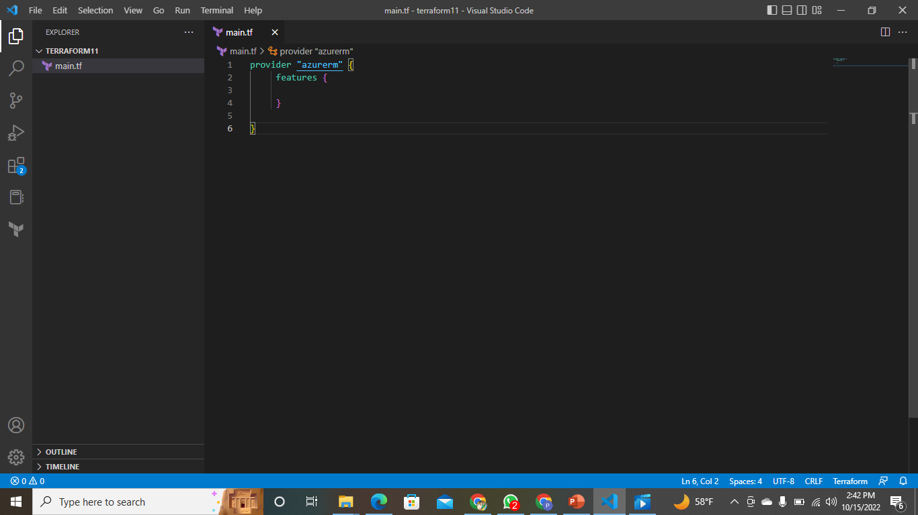
Creating vm using terraform in vs code

Slide 2
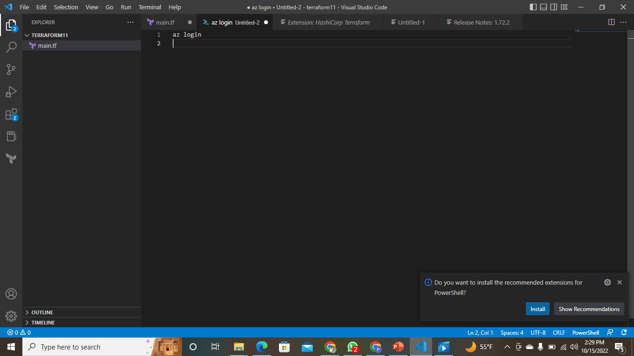
Created main.tf folder

Slide 3
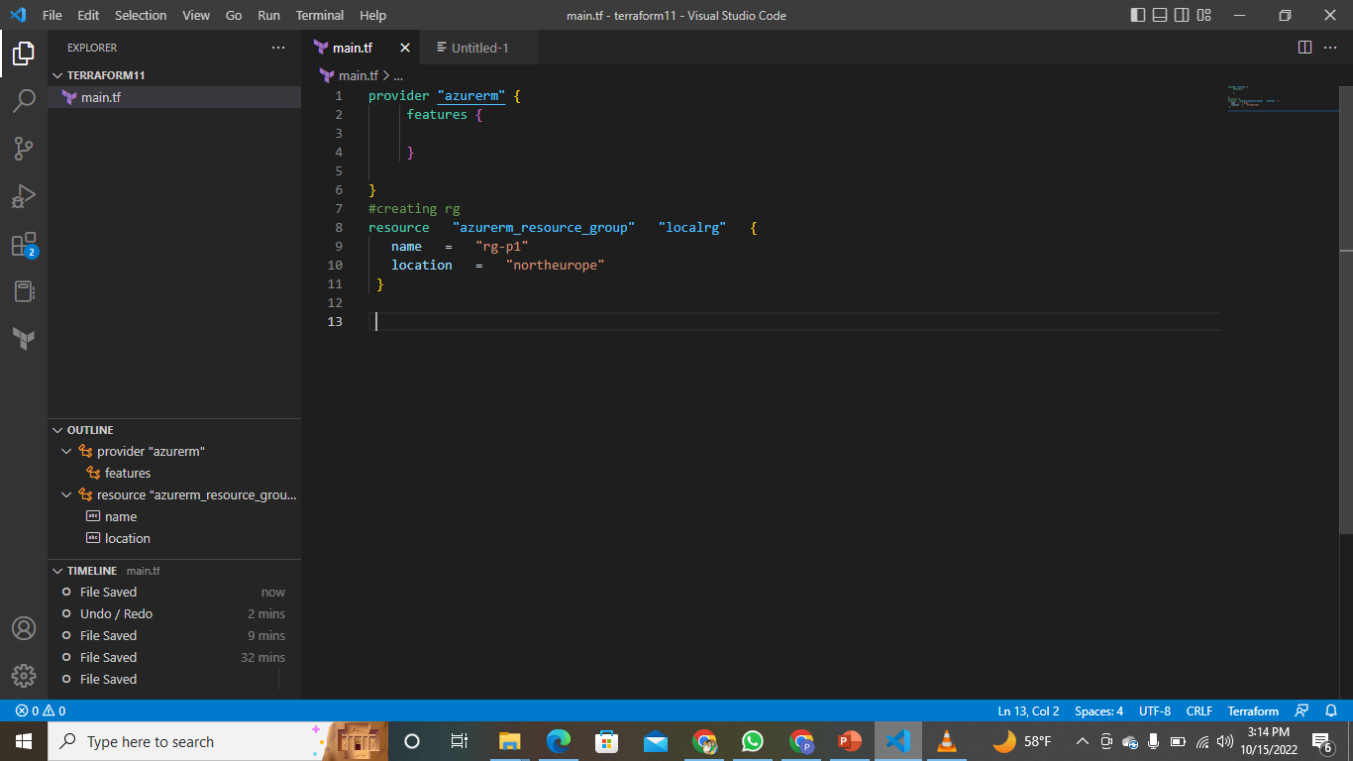
Creating rg

Slide 4
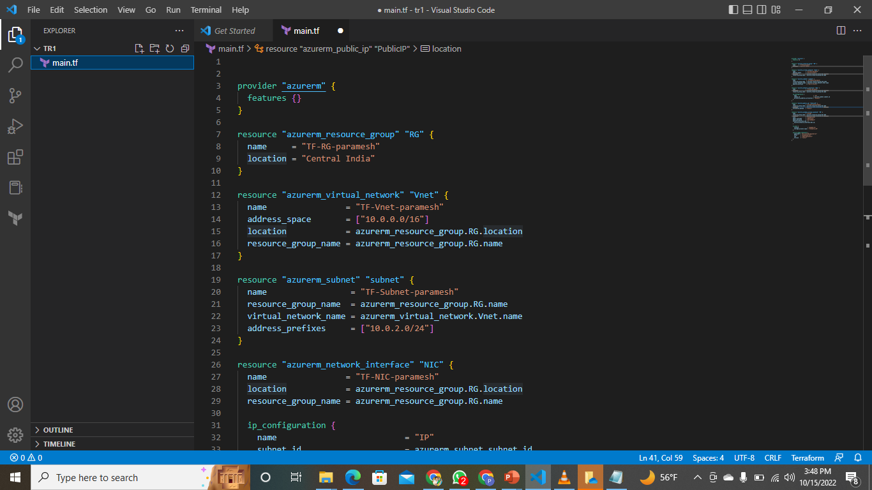
Added all code inside the main.tf folder

Slide 5
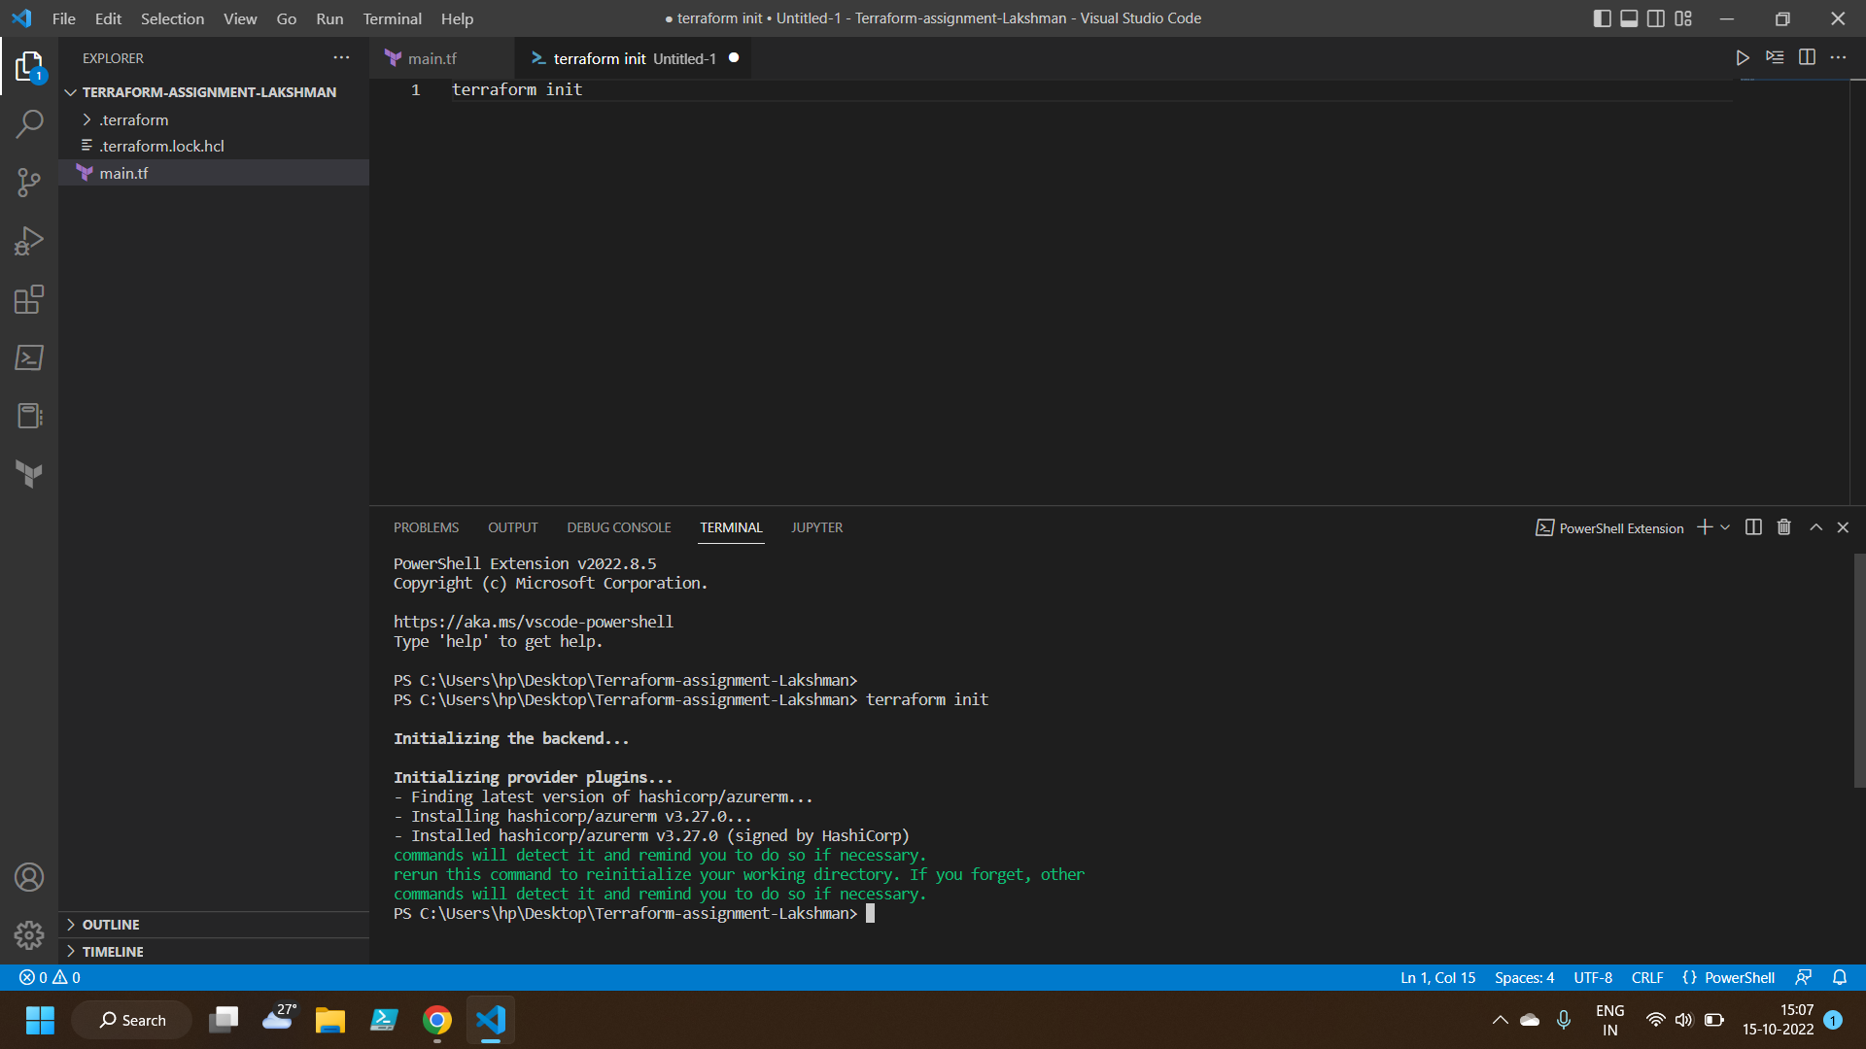
using Powershell Initializing

Slide 6
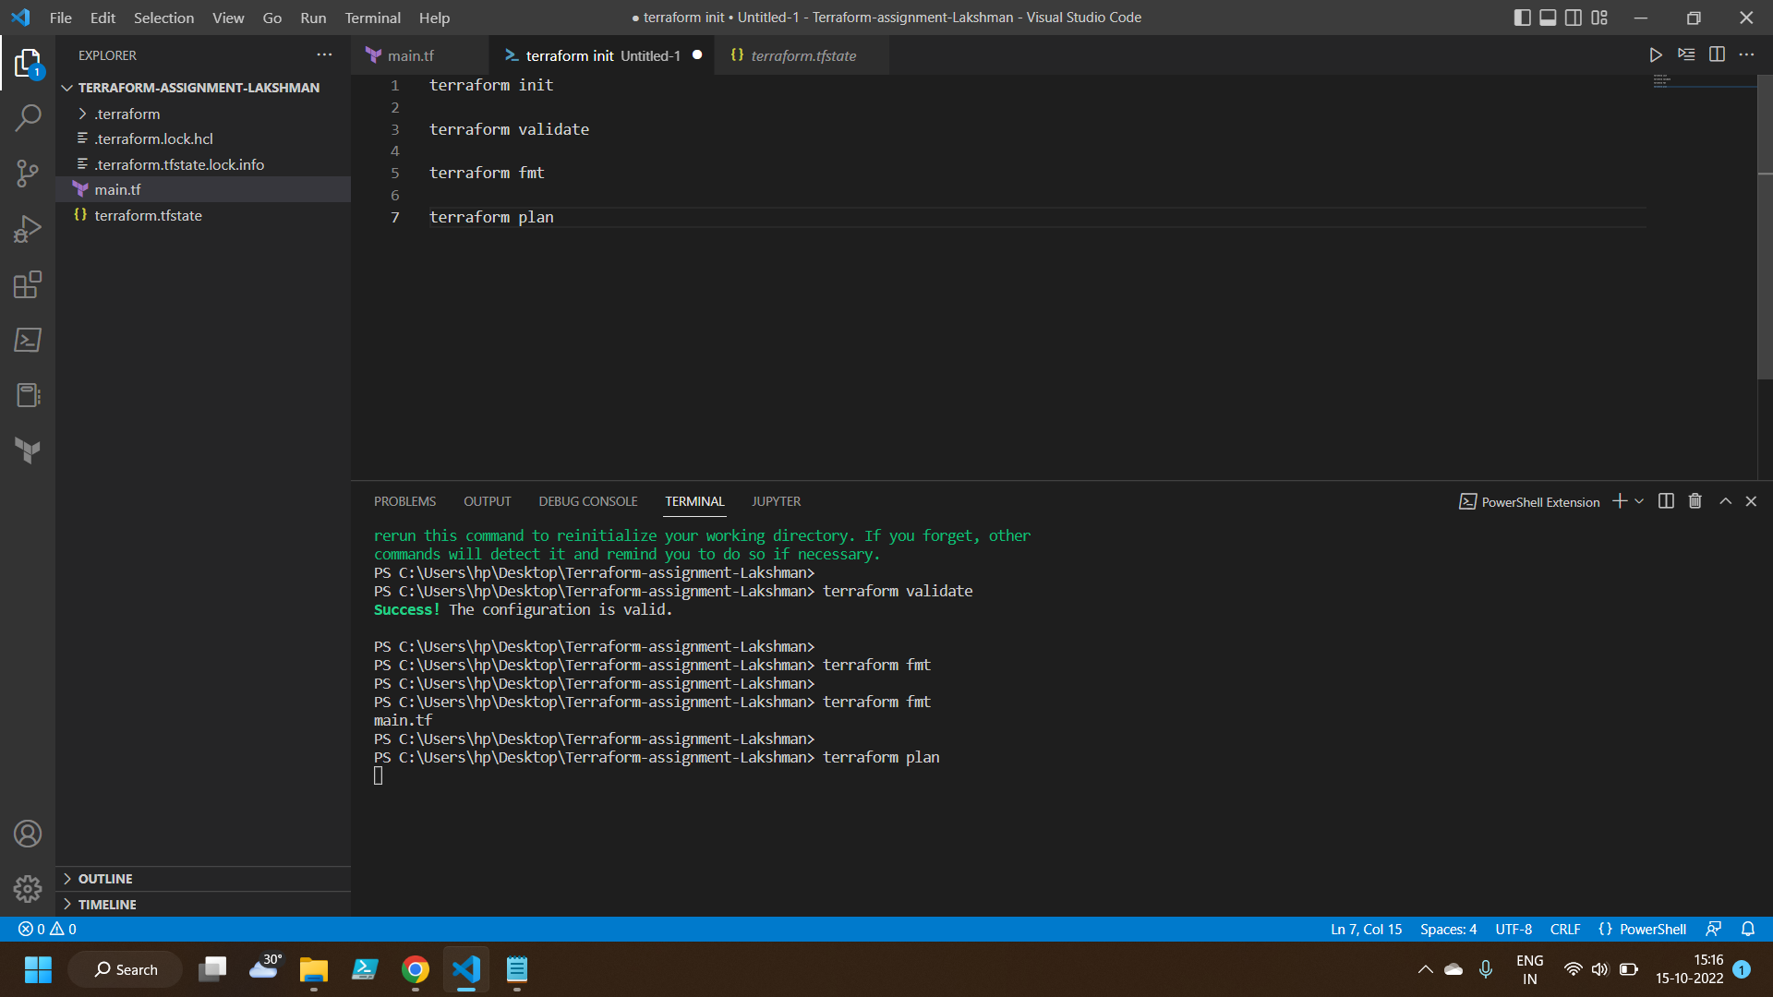
Initializing Terraform plan

Slide 7
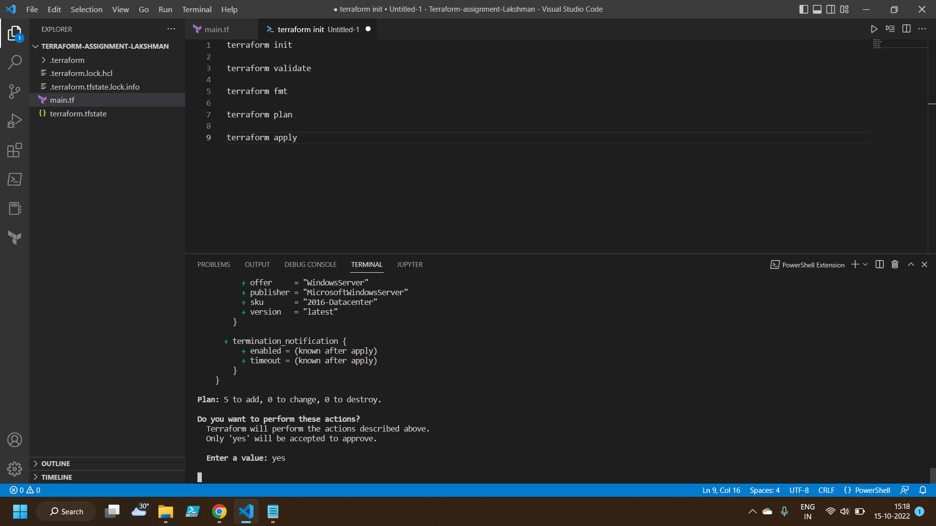
Applied terraform

Slide 8
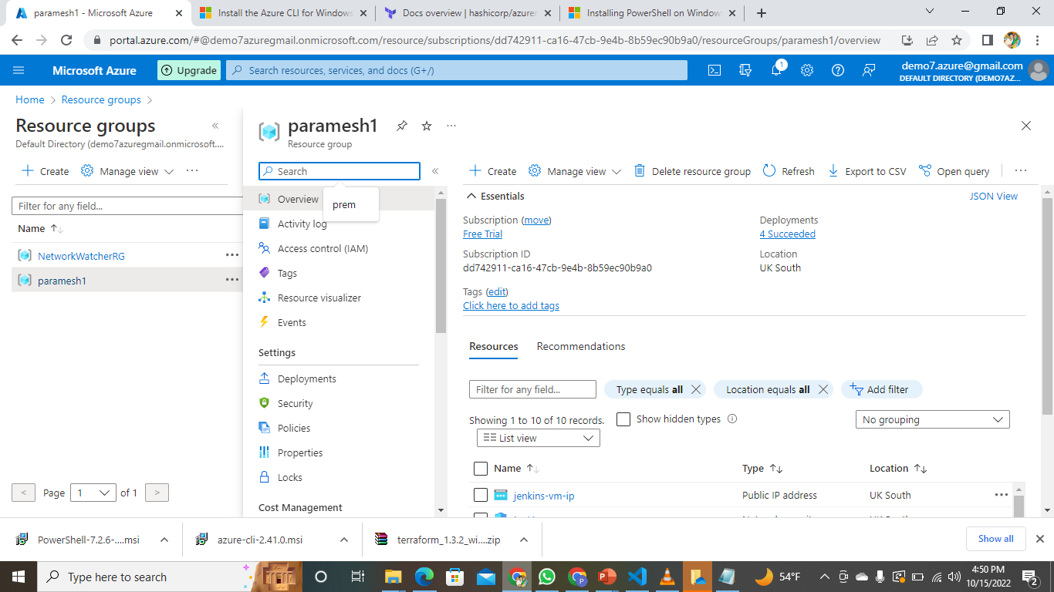
Created rg

Slide 9
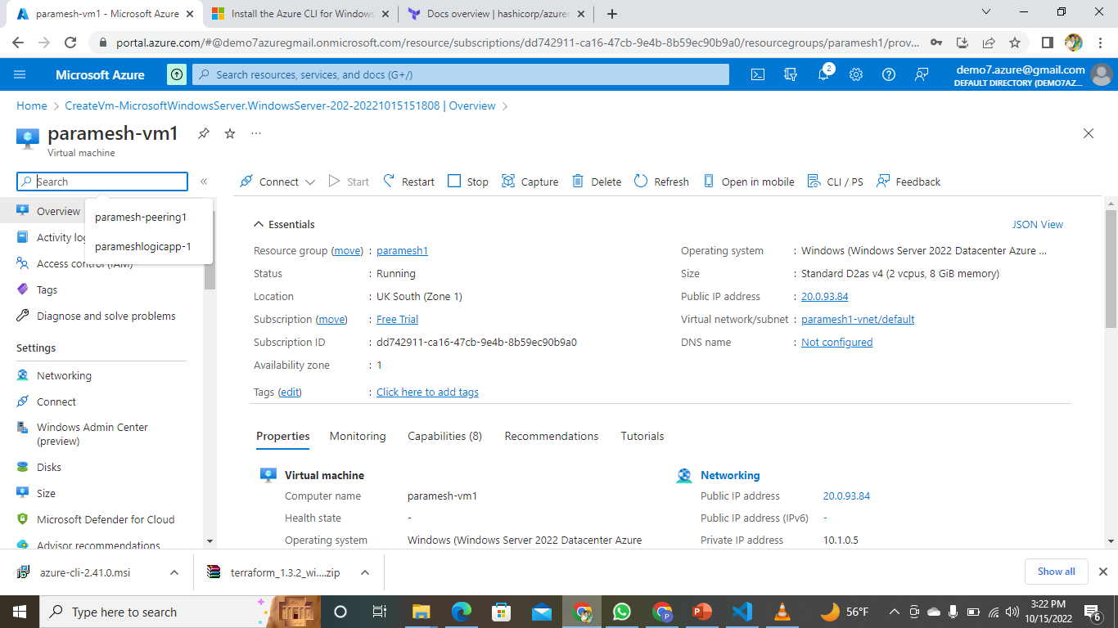
Created vm using terraform

